Slide 1
Primary Exit Profile
Bringing Abilities to Light

Slide 2
The Vision
Things and times have changed…….
Our young people need to be well prepared for the challenges and opportunities in these times and those they will meet in their adulthood.
The curriculum has changed to reflect a greater focus on concepts, skills and competencies.
Notes:
What do you envision Jamaica to be like in the next 10, 50 years? Based on past development trends we can agree that it will be totally different from what we are currently experiencing. Therefore, we need to prepare our students to succeed in a world that we have no clue about. How do we go about doing that?

Slide 3
What are the 21st Century Skills Promoted in the National Standards Curriculum?
True mastery of any subject involves a student being able to apply subject content, skills and abilities in different ways to solve a problem.
Mastery = Subject Content + Skills
Notes:
Use the ideas expressed in this slide as a transition into explaining the importance of parents developing skills (4C) in the home as a first step in preparing their children for PEP.

Slide 4
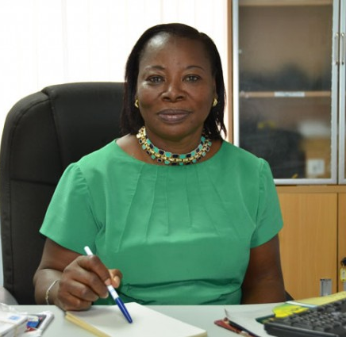
Development of 21st Century Skills
How can each stakeholder assist students develop the 4Cs?

Slide 5
Critical Thinking
Critical thinking involves solving complex issues and problems by analysing and interpreting information to make informed judgements and decisions.

Slide 6
Creativity
Creativity and innovation involves the ability to turn ideas into action to meet the needs of the society. It involves:
thinking outside the box
experimenting with new techniques, materials, strategies or perspectives

Slide 7
Communication
Communication involves the ability to articulate or explain ideas clearly. This may be done orally or in written form.

Slide 8
Collaboration
Collaboration involves working together in teams to accomplish a common goal.

Slide 9
Addressing the public’s questions

Slide 10
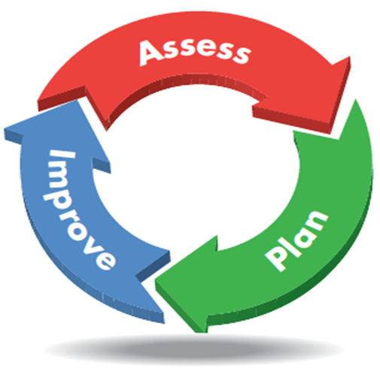
The National Assessment Programme (Revised)

Slide 11
The National Assessment Programme (Revised)
The Grade One Individual Learning Profile
The Grade 2 Diagnostic Test
The Grade 4 Literacy and Numeracy Test
The Primary Exit Profile
The Grade Nine Diagnostic Test

Slide 12
What is the Primary Exit Profile?
The Primary Exit Profile (PEP) is a series of assessments that will replace the existing Grade Six Achievement Test (GSAT).
PEP will assess students’ knowledge in addition to placing increased emphasis on assessing students’ demonstration of the 21st century skills (e.g. critical thinking, communication)

Slide 13
The Purpose of PEP
It will be used to generate an academic profile of each student
It will provide accurate information about students’ knowledge, abilities, and skills and across several subject areas
It will measure students’ readiness for grade 7.
It will function as a means of placing students in secondary schools.

Slide 14
Why change to a new assessment?
Since the curriculum has changed to include an emphasis on skills, the assessment must also change to measure:
students’ knowledge of concepts and
application of the skills

Slide 15
What are the benefits of this new approach to assessment?
More accurate claims will be made about what students know and can do with this knowledge
Students’ achievement of the curriculum and their progress will be monitored more regularly
More opportunities will be provided for teachers to identify students’ strengths and weaknesses and therefore plan lessons to meet the specific needs of students

Slide 16
What are the Components of PEP
Curriculum Based Test
Ability Test
Performance Task

Slide 17
Curriculum Based Test
Subjects to be assessed are Mathematics, Language Arts, Science and Social Studies.
Will sample content in the grade 6 curriculum ONLY
Will consist of multiple choice items along with other item types.

Slide 18
Ability Test
Will assess students’ aptitude in areas of numeracy, verbal and non-verbal abilities, and abstract thinking abilities.
Requires students to read analytically and demonstrate quantitative reasoning skills.
NOT based on curriculum
Will be administered in Grade 6

Slide 19
Performance Task
A performance task is an activity or assessment that asks students to perform to demonstrate their knowledge, understanding and proficiency
Performance Tasks use real world scenarios
It will require students to apply a variety of skills to complete the task; not just recall of information

Slide 20
Performance Task
Will be curriculum based and assess students’ grasp of content coming from Mathematics, Science, Language Arts, and Social Students
Performance Tasks will be prepared by the MoEYI and sent to schools
It will be administered once in grade 4, once in grade 5 and once in grade 6.
It will be administered by the teacher within the student’s classroom. Students should be more comfortable as they will do their Performance Tasks in a familiar space and it will be administered by a familiar face.

Slide 21
Performance Task
Grade | Subjects that will be assessed
6 | Mathematics Language Arts
5 | Mathematics Language Arts Science Social Studies
4 | Mathematics Language Arts

Slide 22
At which grade levels will the various components of PEP be administered?
Grade | Performance Task | Ability Test | Curriculum Based Test
6 | ✓ | ✓ | ✓
5 | ✓
4 | ✓

Slide 23
At what time of year will the Grade 6 Components be Administered?
Grade 6 Components | Time
Performance Task (Mathematics and Language Arts) | November – December
Ability Test | February
Curriculum Based Test (Mathematics, Language Arts, Science and Social Studies | April

Slide 24
Suggested Weighting
Ability Test – 30%
Curriculum Based Test and Performance Tasks – 70%
Ability Test
30%
Curriculum Based Test
Performance Task
70%

Slide 25
How will PEP be implemented?
PEP will be implemented on a phased basis:
Students who are currently in Grade 5 will be the first PEP cohort. They will do only the Grade 6 components in 2019
Students who are currently in Grade 4 will do their Grade 5 Performance Task in 2019 and in 2020 they will do the Grade 6 components.

Slide 26
How will PEP be implemented?
Students who are currently in Grade 3 will be the first cohort that will have a complete profile generate, they will do:
Grade 4 PT in 2019
Grade 5 PT in 2020
and ALL grade 6 components (PT, CBT and AT) in 2021

Slide 27
How will Placement in Secondary School be affected
The placement mechanism will remain the same with students having seven (7) school choices.
The first 5 choices will be any school of choice across the island. The 6th and 7th choice must be made from the cluster list of schools.
The assessment results will also be made available as is customary during the third week of June.

Slide 28
PEP Preparation Activities
In an effort to prepare the system for the roll out of this new assessment, a number of activities will take place during this school year to prepare students, teachers and parents to allow for a smooth implementation.

Slide 29
Activities | Date
Training of Grade 4 Teachers on assessing the 21st century learner | May – June 2017
Training of Assessment Coordinators | Began in October 2017 Will be Ongoing
Training of Grade 5 Teachers on assessing the 21st century learner | November – December 2017
Town Hall Meetings with the Public | November – December 2017
Publication of sample item types | May/June 2018
Training of Grades 4 and 5 teachers | May 2018
National Pilot of Performance Tasks for Grade 4 | June 2018
National Pilot of Performance Tasks for Grade 5 | June 2018
Training of Grade 6 teachers | July - August 2018
Test Preparation Material | September 2018

Slide 30
Next Steps
Key note: PEP is a series of assessments that will require students to demonstrate their knowledge, skills and ability in multiple ways.
Get involved in your child’s school:
Attend PTA Meetings (schools give important information during these forums)
Partner with your child's teacher to help develop these skills

Slide 31
Next Steps
For more information:
Website http://www.moe.gov.jm/
Ministry of Education Youth & Information
@MOEYIJamaica
922-5680/ 922-2420/ 948-9254

Slide 32
QUESTIONS

Slide 33
Accessing the National Standards Curriculum Online
http://moeschools.edu.jm/

